Slide 1




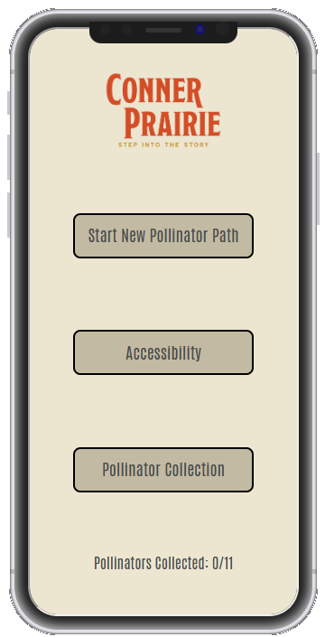
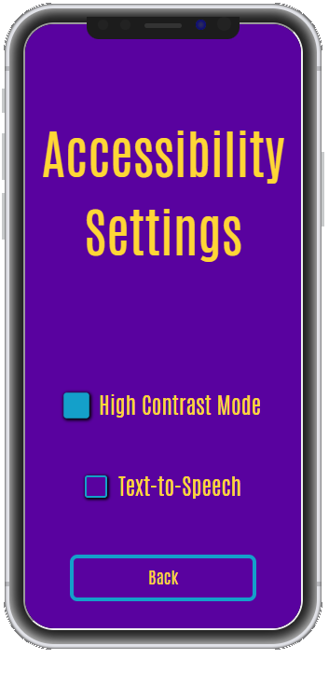
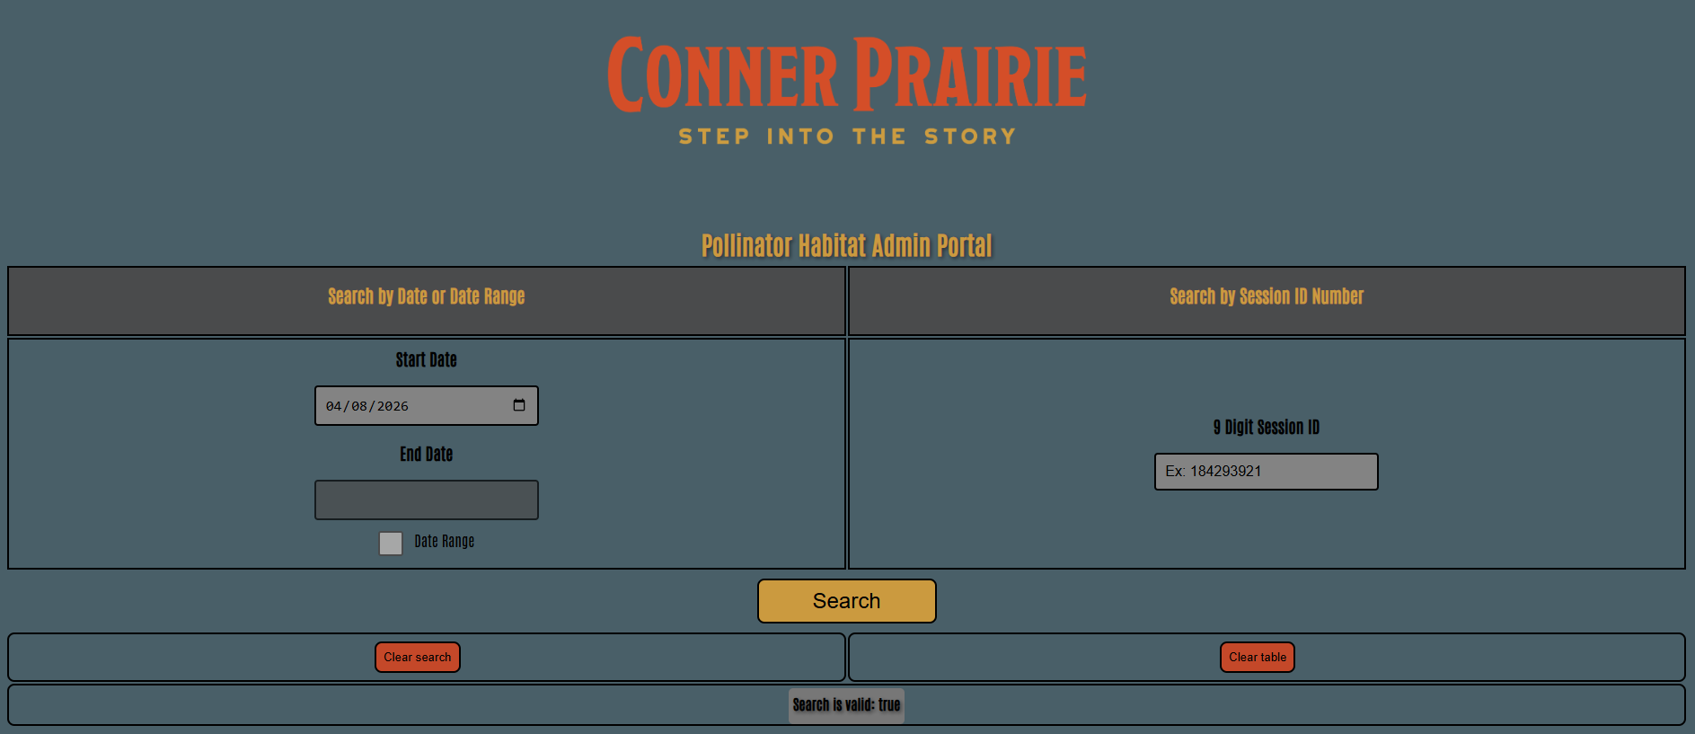



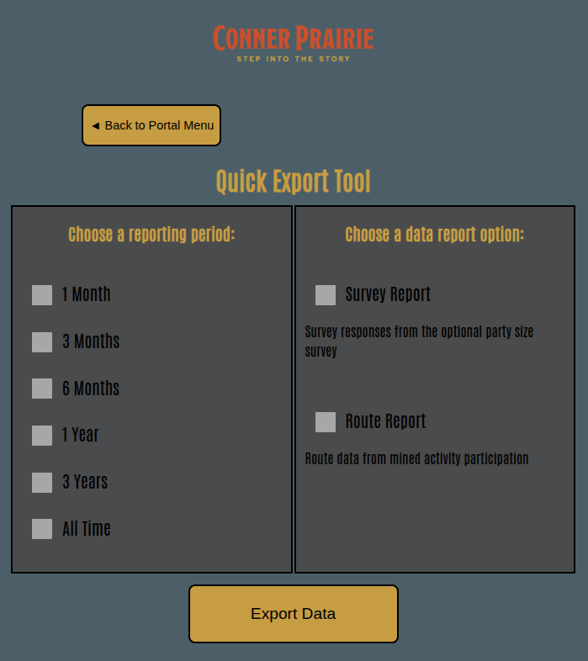
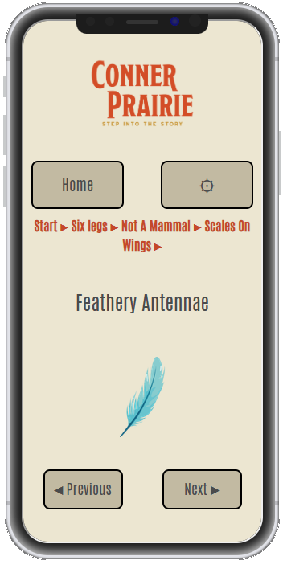
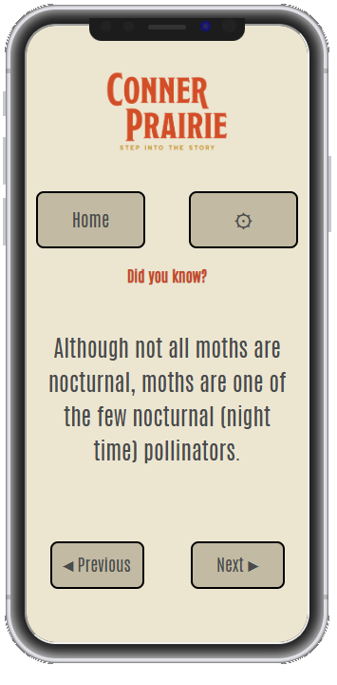
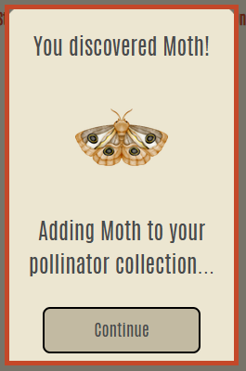
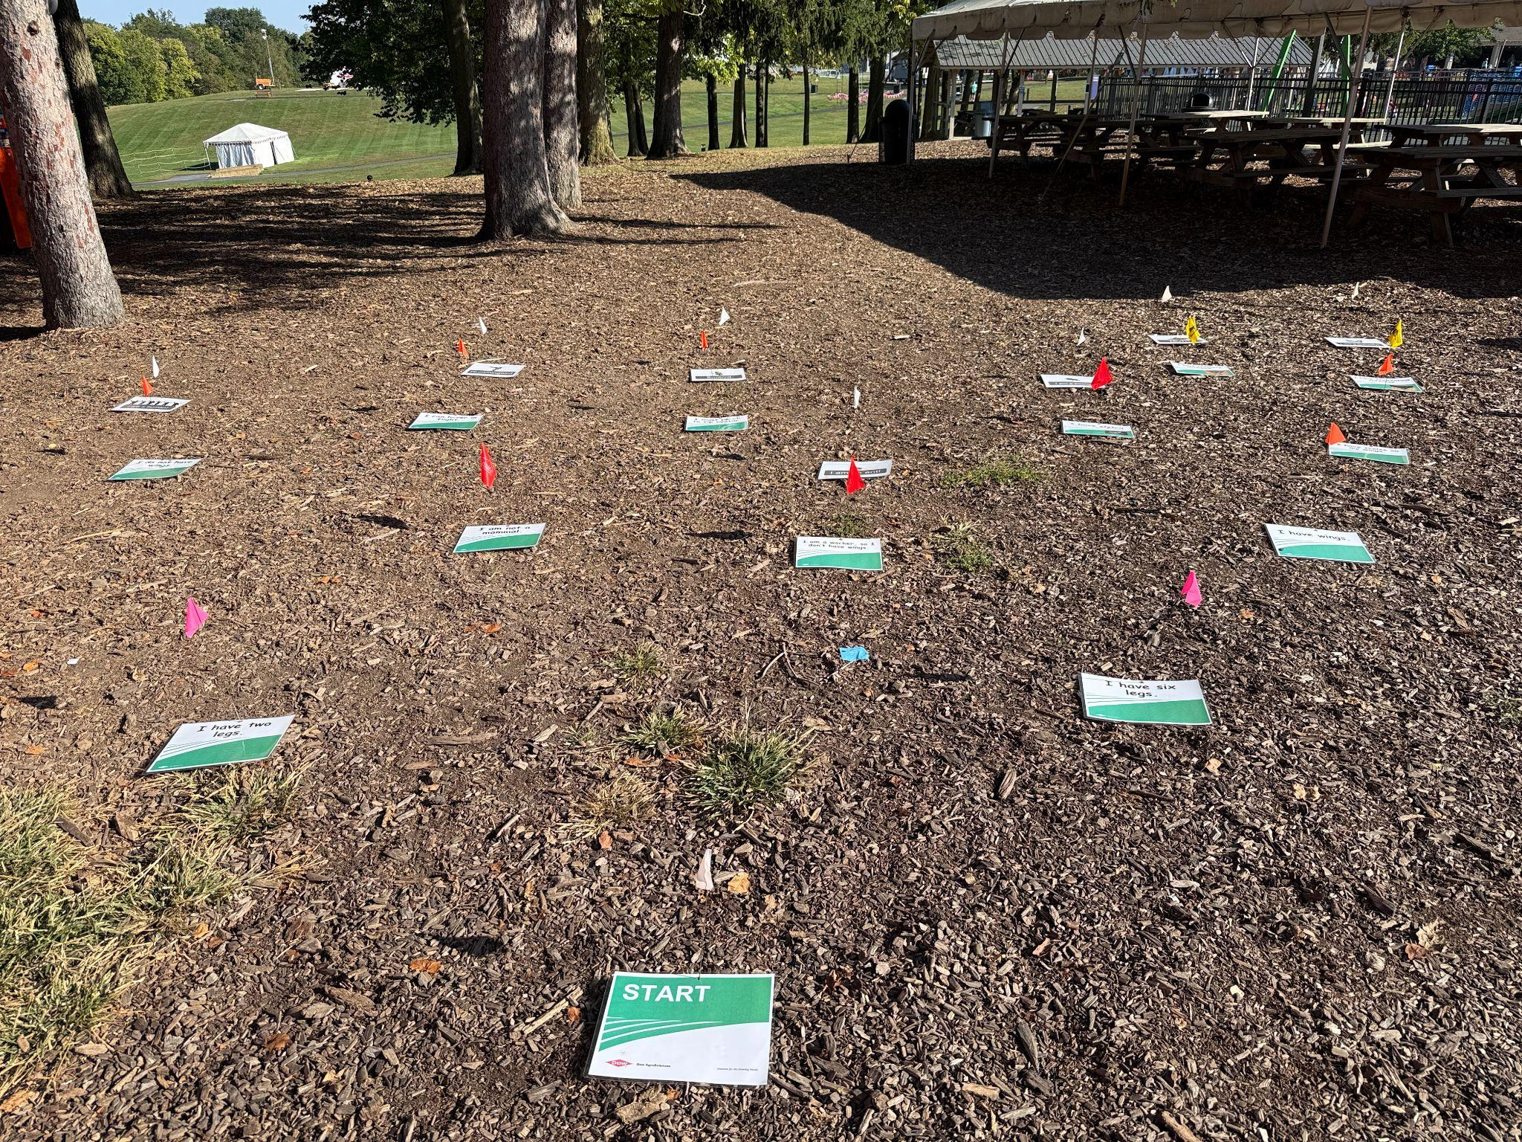
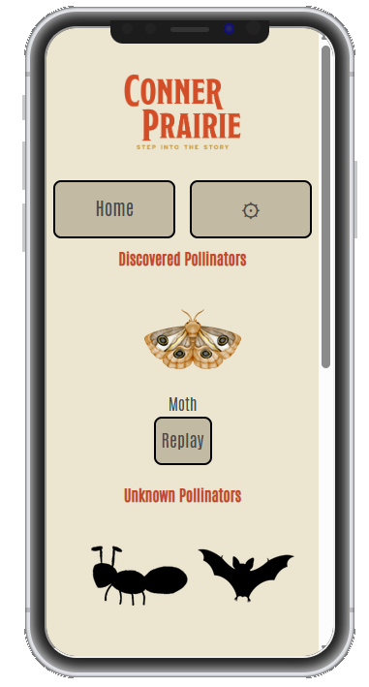
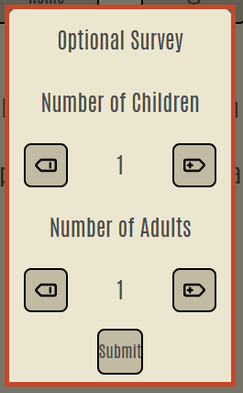
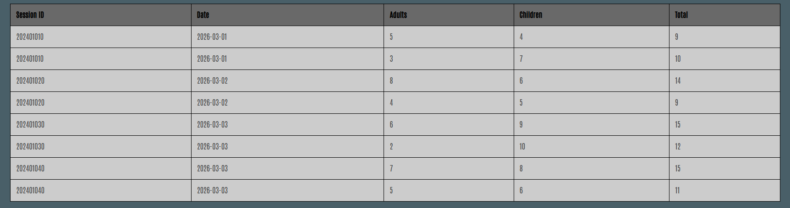
Software Engineering Senior Capstone Project
Pollinator Habitat
C.J. Fulciniti, Camden Hovell, Campbell Reed, Evan Kiser
Ball State University, Computer Science Department
Tech - Stack
External Features
Internal Features
Conclusion
Design UI & UX from the target audience's perspective (children)
Prototype fast and implement feedback from real users
Intentional design plans to avoid future pitfalls
Simplicity is better in public software
Clarify design questions with non-technical individuals
Gameplay design for ease-of-use and fast replayability
Purposeful functionality limits to protect the user from themself
Statistics Search Filters
Home
Settings
Purpose
Digitizing a paper-based educational activity to teach Conner Prairie guests about various pollinators in a fun and interactive way
Gameplay
Facts
Statistics CSV Export
Acknowledgements
Faculty Mentor
Huseyin Ergin, Ph.D.
Associate Professor of Computer Science (Ball State University)
Client
Ronda Hamm, Ph.D.
Director of Food, Farm, and Energy Experience (Conner Prairie)
Collection
Data Collection
Example Statistics

